Slide 1
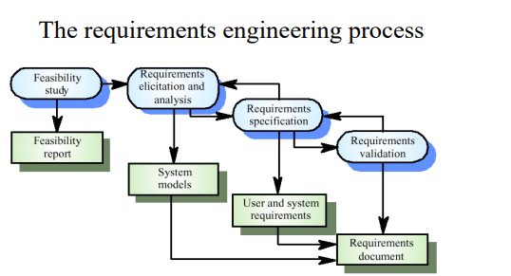
Prof. Rajarajeswari

Slide 2
Inception / Feasibility
• Identify stakeholders
• Recognize multiple points of view
• Work toward collaboration
The first questions
Who is behind the request for this work?
Who will use the solution?
What will be the economic benefit of a successful solution
Is there another source for the solution that you need

Slide 3
Feasibility studies
• A feasibility study decides whether or not the proposed system is worthwhile
• A short focused study that checks
If the system contributes to organizational objectives
If the system can be engineered using current technology and within budget
If the system can be integrated with other systems that are used
Feasibility study Implementation
Based on information assessment (what is required), information collection and report writing
Questions for people in the organization
What if the system wasn’t implemented?
What are current process problems?
How will the proposed system help?

Slide 4
What will be the integration problems?
Is new technology needed? What skills?
What facilities must be supported by the proposed system?
Eliciting

Slide 5
Eliciting Requirements
• Meetings are conducted and attended by both software engineers and customers
• Rules for preparation and participation are established
• An agenda is suggested
• A "facilitator" (can be a customer, a developer, or an outsider) controls the meeting
• A "definition mechanism" (can be work sheets, flip charts, or wall stickers or an electronic bulletin board, chat room or virtual forum) is used

Slide 6
The goal is
To identify the problem
Propose elements of the solution
Negotiate different approaches, and
Specify a preliminary set of solution requirements

Slide 7
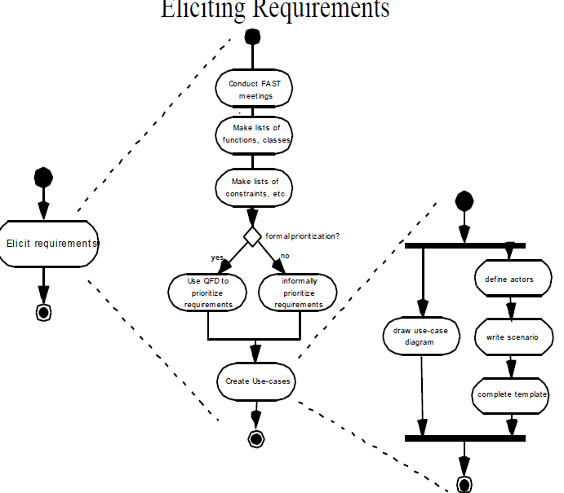

Slide 8
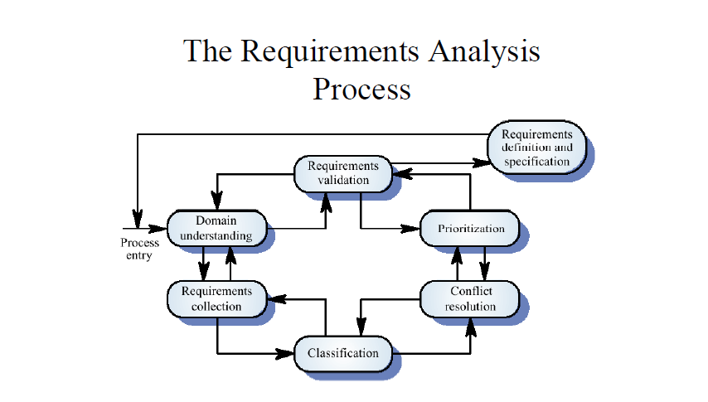

Slide 9
Problems of Requirements Analysis
• Stakeholders don’t know what they really want.
• Stakeholders express requirements in their own terms.
• Different stakeholders may have conflicting requirements.
• Organizational and political factors may influence the system requirements.
• The requirements change during the analysis process. New stakeholders may emerge and the business environment change.
Process Activities
• Domain understanding
• Requirements collection
• Classification
• Conflict resolution
• Prioritisation
• Requirements checking

Slide 10
Building the Analysis Model
• Elements of the analysis model
Scenario-based elements
• Functional—processing narratives for software functions
• Use-case—descriptions of the interaction between an “actor” and the system
Class-based elements
• Implied by scenarios

Slide 11
Behavioral elements
• State diagram
Flow-oriented elements
• Data flow diagram

Slide 12
System Models
• Different models may be produced during the requirements analysis activity
• Requirements analysis may involve three structuring activities which result in these different models
Partitioning. Identifies the structural (part-of) relationships between entities
Abstraction. Identifies generalities among entities
Projection. Identifies different ways of looking at a problem

Slide 13
Receivers of services
Viewpoints are external to the system and receive services from it. Most suited to interactive systems

